Slide 1
Developing an Item Recognition System using Deep Learning Project-I (CS47005) Presentation
Presented by: Aseem Anand (Roll No: 19CS10013)
Under the supervision of: Professor Pabitra Mitra
Department of Computer Science and Engineering, IIT Kharagpur
Date: November 7, 2024

Slide 2
Develop a system to identify specific items within images containing multiple objects
Key Challenges:
Irrelevant Features: Exclude stands and backgrounds from influencing item recognition.
Large Number of Classes: Over 1,000 items with high intra-class similarity.
Similar Appearances: Items that look alike make classification difficult.
Importance:
Enhances object detection accuracy in cluttered environments.
Applicable in retail, automation, robotics, and more

Slide 3
Dataset Overview
Dataset Used: Retail Product Dataset (or specify the exact name).
Contents: Total Images: Over 50,000. Number of Classes: 200 unique item classes.
Data Characteristics: Images with multiple objects. Annotations provided in COCO format.
Sources:
Kaggle Retail Product Checkout Dataset: Collected from retail environments to reflect real-world scenarios.

Slide 4
Data Challenges
Diversity and Similarity: High intra-class similarity (items within a class look very similar). Low inter-class variability (different classes may appear similar).
Presence of Stands: Items are placed on uniform stands that dominate the image space. Stands may distract the model from focusing on the items.
Image Quality Variations: Differences in lighting conditions. Varied image resolutions and perspectives.

Slide 5
Data Preparation
Annotation Conversion: Transformed COCO annotations to YOLO format for compatibility.
Excluding Irrelevant Features: Adjusted bounding boxes to exclude stands. Applied image preprocessing techniques.
Handling Class Imbalance: Used data augmentation. Applied weighted loss functions.

Slide 6
System Architecture
Components: Object Detection Model: YOLOv5. Feature Extraction Model: ResNet50.
Workflow Overview: 1. Detect objects in the target image using YOLOv5. 2. Extract features from detected objects using ResNet50. 3. Extract features from the query item. 4. Compare features to find matches.
Goal: Accurately identify and localize specific items within complex images.

Slide 7
Object Detection with YOLOv5
Why YOLOv5? Real-time object detection capability. High accuracy with efficient computation.
Training Details: Number of training cycles (50 epochs). Batch Size: Number of images processed together (16). Image Size: Resized images to 640x640 pixels.
Training Process: Used data augmentation techniques like flipping, scaling. Monitored validation loss to prevent overfitting.
Challenges Addressed: Excluding stands from detection. Managing large numbers of classes.

Slide 8
Feature Extraction and Matching
Feature Extractor: Pre-trained ResNet50 model.
Process: Removed the final classification layer to use ResNet50 as a feature extractor. Extracted high-level features from images.
Feature Matching: Calculated cosine similarity between feature vectors. Set a similarity threshold to determine matches (e.g., 0.8).
Advantages: Captures intricate details of items. Improves the accuracy of item recognition by focusing on features rather than entire images.

Slide 9
Results: Model Performance Metrics
Class | Images | Instances | Box(P) | R | mAP50 | mAP50-95
all | 6000 | 73602 | 0.651 | 0.728 | 0.746 | 0.628
1_puffed_food | 1991 | 4763 | 0.634 | 0.707 | 0.738 | 0.605
2_puffed_food | 1610 | 3408 | 0.645 | 0.712 | 0.754 | 0.626
3_puffed_food | 1540 | 3168 | 0.629 | 0.686 | 0.701 | 0.585
4_puffed_food | 1597 | 3667 | 0.614 | 0.698 | 0.729 | 0.594
5_puffed_food | 1978 | 4538 | 0.646 | 0.704 | 0.743 | 0.611
6_puffed_food | 2630 | 6642 | 0.672 | 0.743 | 0.762 | 0.647
7_puffed_food | 2493 | 6041 | 0.668 | 0.713 | 0.738 | 0.613
8_puffed_food | 1864 | 3965 | 0.647 | 0.67 | 0.711 | 0.606
9_puffed_food | 1737 | 3998 | 0.656 | 0.704 | 0.727 | 0.611
10_puffed_food | 1868 | 4408 | 0.67 | 0.759 | 0.776 | 0.649
11_puffed_food | 1945 | 4494 | 0.68 | 0.771 | 0.788 | 0.665
12_puffed_food | 1390 | 3087 | 0.639 | 0.728 | 0.742 | 0.626
13_dried_fruit | 1709 | 3776 | 0.654 | 0.712 | 0.748 | 0.622
14_dried_fruit | 2107 | 4910 | 0.611 | 0.678 | 0.704 | 0.588
15_dried_fruit | 1640 | 3728 | 0.662 | 0.746 | 0.766 | 0.646
16_dried_fruit | 2756 | 6952 | 0.686 | 0.764 | 0.785 | 0.663
17_dried_fruit | 1034 | 2057 | 0.605 | 0.676 | 0.693 | 0.574
Metrics: Accuracy: 0.651. Precision: 0.728. Mean Average Precision (mAP): 0.746 mAP@0.5:0.95 (mean): 0.628

Slide 10
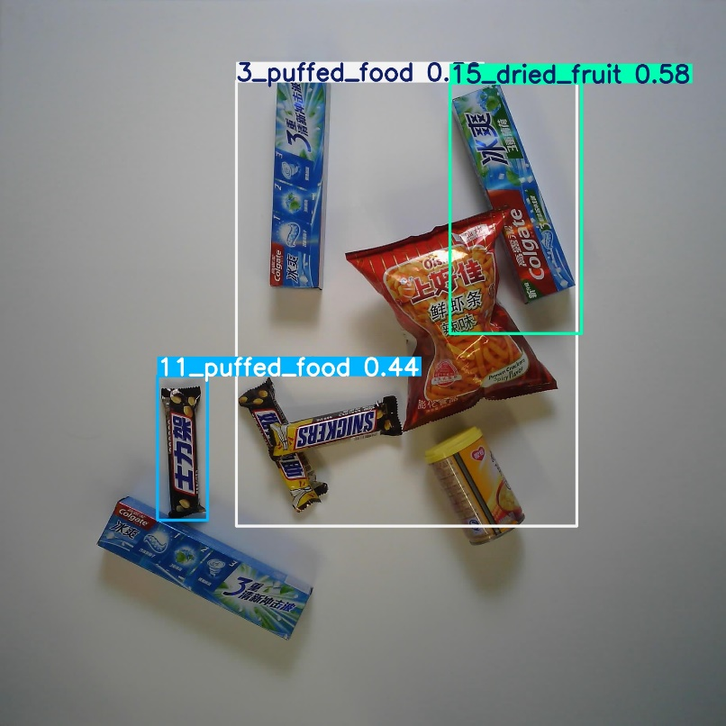
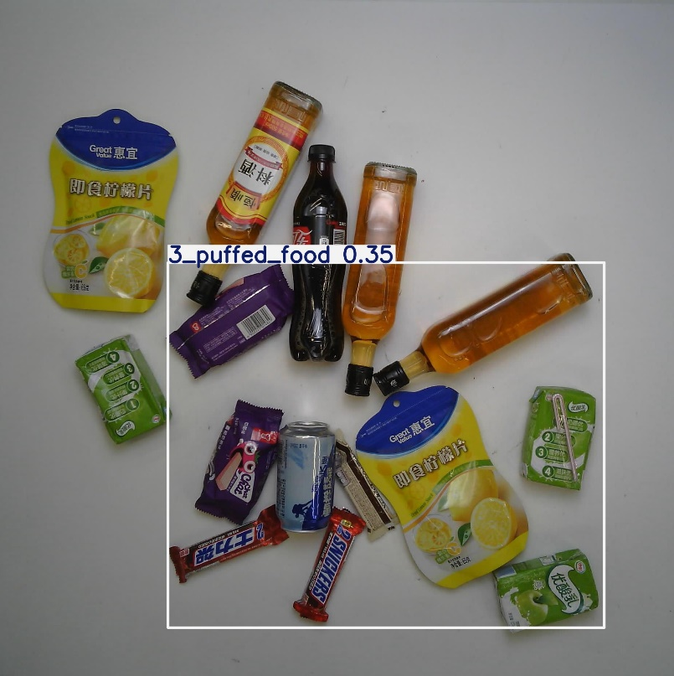

Detection and Recognition Examples
Example outputs:

Slide 11
Performance Analysis
Interpretation of the Metrics:
The model achieved a mean average precision (mAP@0.5) of 0.746, demonstrating its ability to detect objects with good accuracy at loose localization thresholds.
The mAP@0.5:0.95 value of 0.628 indicates decent overall localization performance, though tighter bounding box placements need refinement.
A precision of 0.651 reflects the model's ability to minimize false positives, while a recall of 0.728 suggests it successfully identifies most true positives, but some objects are missed.

Slide 12
Performance Analysis
Strengths of the Model:
Balanced precision and recall make the model suitable for practical applications, ensuring reliable object detection with minimal false positives or negatives.
Consistent performance across all 17 classes indicates the model generalizes well and does not exhibit significant bias toward or against specific object types.
The model performs particularly well in scenarios where moderately accurate localization is sufficient, such as inventory management and surveillance.

Slide 13
Performance Analysis
Areas Where the Model Struggled and Potential Reasons:
The gap between mAP@0.5 and mAP@0.5:0.95 suggests the model struggles with tight bounding box placement, especially for small or occluded objects.
Lower recall in specific challenging scenarios, such as detecting objects in cluttered environments, may contribute to missed detections.
Similar-looking items (e.g., items with comparable shapes, colors, or packaging) could confuse the model, leading to false positives or inaccurate bounding boxes.
The model's performance under poor lighting conditions or with partially visible objects might be suboptimal, as such situations require more robust feature extraction.

Slide 14
Improvements and Enhancements
Model Refinement: Hyperparameter Tuning: Adjust learning rates, batch sizes, etc. Model Architecture: Experiment with different neural network architectures.
Data Augmentation: Incorporate more diverse transformations. Generate synthetic data to balance classes.
Exclude Irrelevant Features: Implement advanced segmentation techniques to better isolate items. Use attention mechanisms to focus the model on items rather than backgrounds.

Slide 15
Potential Goals
Real-Time Deployment: Optimize the model for deployment on edge devices or mobile platforms.
Broader Applications: Retail Automation: Automated checkout systems, inventory management. Robotics: Integrate with robotic systems for item picking and sorting. Augmented Reality: Use in AR applications for item recognition and information overlay.
Integration with Other Modalities: Combine with text recognition (OCR) for items with labels or barcodes. Use multi-modal data (e.g., combining visual and textual data).

Slide 16
Conclusion
Project Achievements: Developed a system capable of recognizing specific items in complex images. Addressed challenges related to dataset complexities and irrelevant features.
Key Takeaways: Importance of data preprocessing in model performance. Effectiveness of combining object detection with feature matching.
Impact: Potential to improve efficiency in industries like retail and automation. Foundation for future research and development in item recognition systems.

Slide 17
References
Kaggle Retail Product Checkout Dataset: Kaggle Dataset
YOLOv5 Documentation: Ultralytics. YOLOv5
ResNet Paper: He, K., Zhang, X., Ren, S., & Sun, J. (2016). Deep Residual Learning for Image Recognition. Proceedings of the IEEE Conference on Computer Vision and Pattern Recognition (CVPR), 770-778. Deep Residual Learning for Image Recognition
COCO Dataset: Lin, T.-Y., et al. (2014). Microsoft COCO: Common Objects in Context. arXiv preprint arXiv:1405.0312. COCO Dataset
OpenCV Documentation: OpenCV
PyTorch Documentation: PyTorch

Slide 18
Thank-you
Email: aseem.anand.0609@gmail.com

